Slide 1
Relational Database Management System
Collection of information organized in tables
Tables are also “relations”
Tables are constructed and associated to each other through shared fields–“common” fields
Fields are also “columns” or “attributes”
A set of attributes comprises a record
Records are also “rows” or “tuples”
Tables are related through common fields designated as primary and foreign keys
Allow us to find, update, and delete data quickly, and help to ensure accuracy

Slide 2
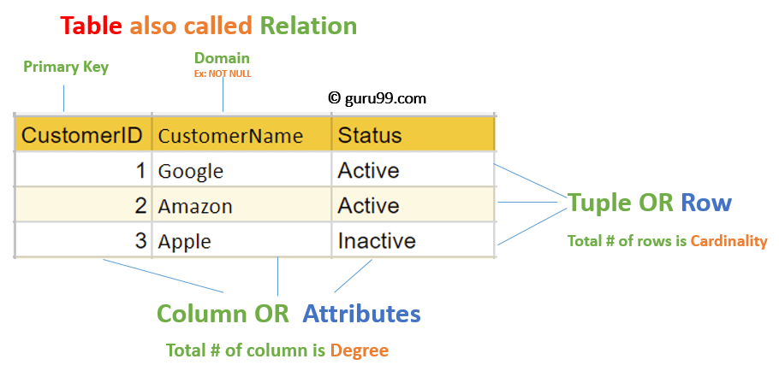

Slide 3
Terminologies
Domain: It contains a set of atomic values that an attribute can take.
Attribute: It contains the name of a column in a particular table. Each attribute Ai must have a domain, dom(Ai)
Relational instance: In the relational database system, the relational instance is represented by a finite set of tuples. Relation instances do not have duplicate tuples.
Relational schema: A relational schema contains the name of the relation and name of all columns or attributes.
Relational key: In the relational key, each row has one or more attributes. It can identify the row in the relation uniquely.
Cardinality: Total number of tuples present in a relation.
Degree of Relation: No. of attributes in a relational schema
Notes:
Atomicity, Consistency, Isolation , Durability

Slide 4
Properties of Relations
Name of the relation is distinct from all other relations.
Each relation cell contains exactly one atomic (single) value
Each attribute contains a distinct name
Attribute domain has no significance
tuple has no duplicate value
Order of tuple can have a different sequence
Notes:
Atomicity, Consistency, Isolation , Durability

Slide 5
Differences Between a Database and a Relational Database
Relational database stores data in a tabular form -- or arranged in a table with rows and columns -- while a database stores data as files.
Database normalization is present in a relational database while it is not present in a database.
A relational database supports a distributed database while a database does not support a distributed database.
In a relational database, the data values are stored in the form of tables and each table possesses a primary key. In a database, data is normally stored in hierarchical or navigational form.
Since data is stored in the form of tables in a relational database, then the relationship between these data values is stored as well. Since a database stores data as files, then there is not relationship between the values or tables.
In a relational database, the integrity constraints are defined for the purpose of an ACID On the other hand, a database does not utilize any security to protect against data manipulation.
While a relational database is designed to support large amounts of data and multiple users, a database is designed to deal with small amounts of data and one single user.
Notes:
Atomicity, Consistency, Isolation , Durability

Slide 6
Advantages of Relational Databases
Simple Model:
The simplest model of the relational database does not require any complex structure or query to process the databases.
It has a simple architectural process as compared to a hierarchical database structure.
Its simple architecture can be handled with simple SQL queries to access and design the relational database.
Data Accuracy:
Relational databases can have multiples tables related to each other through primary and foreign keys.
There are fewer chances for duplication of data fields.
Therefore the accuracy of data in relational database tables is greater than in any other database system.
Easy to access Data:
The data can be easily accessed from the relational database, and it does not follow any pattern or way to access the data.
One can access any data from a database table using SQL queries.
Each table in the associated database is joined through any relational queries such as join and conditional descriptions to concatenate all tables to get the required data.
Security: It sets a limit that allows specific users to use relational data in RDBMS.
Collaborate: It allows multiple users to access the same database at a time.
Notes:
Atomicity, Consistency, Isolation , Durability

Slide 7
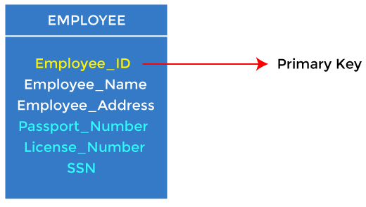
Types of Keys
Primary Key
It is the first key used to identify one and only one instance of an entity uniquely.
An entity can contain multiple keys.
The key which is most suitable from those lists becomes a primary key.
In the EMPLOYEE table, ID can be the primary key since it is unique for each employee.
In the EMPLOYEE table, we can even select License_Number and Passport_Number as primary keys since they are also unique.
For each entity, the primary key selection is based on requirements and developers.

Slide 8
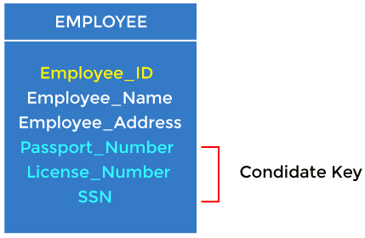
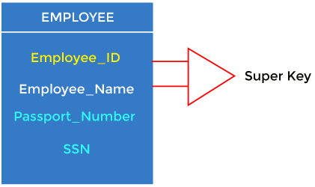
Types of Keys
Candidate Key
A candidate key is an attribute or set of attributes that can uniquely identify a tuple.
Except for the primary key, the remaining attributes are considered a candidate key. The candidate keys are as strong as the primary key.
Super Key
Super key is an attribute set that can uniquely identify a tuple.
A super key is a superset of a candidate key.

Slide 9
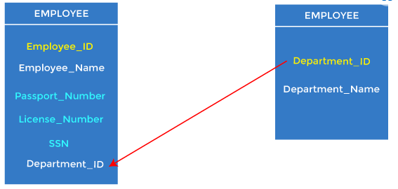
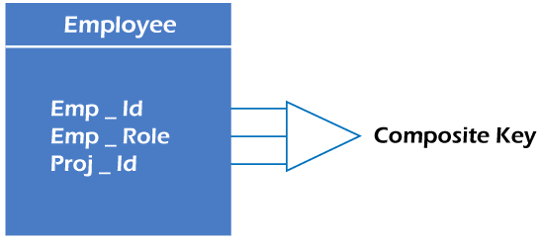
Types of Keys
Foreign Key
Foreign keys are the column of the table used to point to the primary key of another table.
Composite Key
Whenever a primary key consists of more than one attribute, it is known as a composite key.
This key is also known as Concatenated Key.

Slide 10
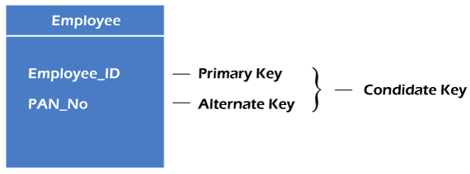
Types of Keys
Alternate Key
There may be one or more attributes or a combination of attributes that uniquely identify each tuple in a relation.
These attributes or combinations of the attributes are called the candidate keys.
One key is chosen as the primary key from these candidate keys, and the remaining candidate key, if it exists, is termed the alternate key.
In other words, the total number of the alternate keys is the total number of candidate keys minus the primary key.
The alternate key may or may not exist. If there is only one candidate key in a relation, it does not have an alternate key.

Slide 11
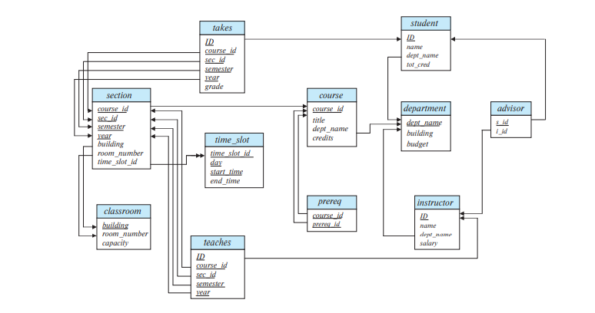

Slide 12
What is Normalization?
The process by which we efficiently organize data to achieve these goals:
Eliminating redundancy
Ensuring data is stored in the correct table
Eliminating need for restructuring database when data is added.
Five levels of normal form
In order to achieve one level of normal form, each previous level must be met
Third normal form is sufficient for most typical database applications.

Slide 13
First Normal Form (1NF)
There are no repeating or duplicate fields.
Each cell contains only a single value.
Each record is unique.
Identified by primary key

Slide 14
Example
item | colors | price | tax
T-shirt | red, blue | 12.00 | 0.60
polo | red, yellow | 12.00 | 0.60
T-shirt | red, blue | 12.00 | 0.60
sweatshirt | blue, black | 25.00 | 1.25
Table is not in first normal form because:
Multiple items in color field
Duplicate records / no primary key

Slide 15
Example
item | color | price | tax
T-shirt | red | 12.00 | 0.60
T-shirt | blue | 12.00 | 0.60
polo | red | 12.00 | 0.60
polo | yellow | 12.00 | 0.60
sweatshirt | blue | 25.00 | 1.25
sweatshirt | black | 25.00 | 1.25
Table is now in first normal form.

Slide 16
Second Normal Form (2NF)
All non-key fields depend on all components of the primary key.
Guaranteed when primary key is a single field.

Slide 17
Example
item | color | price | tax
T-shirt | red | 12.00 | 0.60
T-shirt | blue | 12.00 | 0.60
polo | red | 12.00 | 0.60
polo | yellow | 12.00 | 0.60
sweatshirt | blue | 25.00 | 1.25
sweatshirt | black | 25.00 | 1.25
Table is not in second normal form because:
price and tax depend on item, but not color

Slide 18
Example
item | color
T-shirt | red
T-shirt | blue
polo | red
polo | yellow
sweatshirt | blue
sweatshirt | black
item | price | tax
T-shirt | 12.00 | 0.60
polo | 12.00 | 0.60
sweatshirt | 25.00 | 1.25
Tables are now in second normal form.

Slide 19
Third Normal Form (3NF)
No non-key field depends upon another.
All non-key fields depend only on the primary key.

Slide 20
Example
item | color
T-shirt | red
T-shirt | blue
polo | red
polo | yellow
sweatshirt | blue
sweatshirt | black
item | price | tax
T-shirt | 12.00 | 0.60
polo | 12.00 | 0.60
sweatshirt | 25.00 | 1.25
Tables are not in third normal form because:
tax depends on price, not item

Slide 21
Example
item | price
T-shirt | 12.00
polo | 12.00
sweatshirt | 25.00
item | color
T-shirt | red
T-shirt | blue
polo | red
polo | yellow
sweatshirt | blue
sweatshirt | black
price | tax
12.00 | 0.60
25.00 | 1.25
Tables are now in third normal form.

Slide 22
Another Example
Name | Assignment 1 | Assignment 2
Jeff Smith | Article Summary | Poetry Analysis
Nancy Jones | Article Summary | Reaction Paper
Jane Scott | Article Summary | Poetry Analysis

Slide 23
Another Example
Assignment ID | Student ID
1 | 1
1 | 2
1 | 3
2 | 1
2 | 3
3 | 2
Assignment ID | Description
1 | Article Summary
2 | Poetry Analysis
3 | Reaction Paper
Student ID | First Name | Last Name
1 | Jeff | Smith
2 | Nancy | Jones
3 | Jane | Scott
Tables are in Third Normal Form

Slide 24
Relationships
Relationships are created between tables using the primary key field and a foreign key field
One to One Relationship
One record in a table relates to one record in another table
One to Many Relationship
One record in a table can relate to many records in another table
Many to Many Relationship
Many records in one table can relate to many records in another table

Slide 25
Relational Integrity constraints
Relational Integrity constraints is referred to conditions which must be present for a valid relation.
These integrity constraints are derived from the rules in the mini-world that the database represents.
There are many types of integrity constraints.
Inherent Model based
Schema Based
Application Based
Schema Based Constraints on the Relational database management system is mostly divided into three main categories are:
Domain constraints
Key constraints
Referential integrity constraints

Slide 26
Domain Constraints
Domain constraints can be violated if an attribute value is not appearing in the corresponding domain or it is not of the appropriate data type.
Domain constraints specify that within each tuple, and the value of each attribute must be unique.
This is specified as data types which include standard data types integers, real numbers, characters, Booleans, variable length strings, etc.

Slide 27
Key constraints
An attribute that can uniquely identify a tuple in a relation is called the key of the table.
The value of the attribute for different tuples in the relation has to be unique.
Referential integrity constraints
Referential integrity constraints is base on the concept of Foreign Keys.
A foreign key is an important attribute of a relation which should be referred to in other relationships.
Referential integrity constraint state happens where relation refers to a key attribute of a different or same relation.
However, that key element must exist in the table.

Slide 28
CODD’s 12 Rule
Codd’s 12 rules are a set of thirteen rules (numbered zero to twelve) proposed by Edgar F. Codd. Rule 0: The system has to qualify as Relational, as a Database, and also as a Management System. Rule 1: The information rule: Each and every information in the database is to be represented uniquely, mainly name values in column positions within a different row of a table. Rule 2: The guaranteed access rule: All data must be ingressive. It says that every scalar value in the database must be correctly/logically addressable. Rule 3: Systematic treatment of null values: The DBMS must allow each tuple to remain null. Rule 4: Active online catalog (database’s structure) based on the relational model: The system must support an online, relational etc. structure which is ingressive to allowed users by means of their regular query. Rule 5: The comprehensive data sublanguage: The system has to assist a minimum of one relational language that: 1.Has a linear syntax 2.Which can be used as both interactively and within application programs, 3.It supports data definition operations(DDL), data manipulation operations(DML), security and integrity constraints, and transaction management operations (begin, commit, and rollback).

Slide 29
CODD’s 12 Rule
Rule 6: The view updating rule: All views that theoretically improve must be upgradable by the system. Rule 7: High-level insert, update, and delete: The system must support insert, update, and delete operators. Rule 8: Physical data independence: Modify the physical level (how the data is stored, using arrays or linked lists etc.) must not require a modification to an application. Rule 9: Logical data independence: Modify the logical level (tables, columns, rows etc.) must not require a modification to an application. Rule 10: Integrity independence: Integrity constraints must be identified individually from application programs and stored in the catalog. Rule 11: Distribution independence: The distribution of portions of a database to different locations should not be visible to users of the database. Rule 12: The nonsubversion rule: If the system provides a low-level (i.e. records) interface, then that interface can’t be used to subvert the system.

Slide 30
Disadvantages of using Relational model
Few relational databases have limits on field lengths which can't be exceeded.
Relational databases can sometimes become complex as the amount of data grows, and the relations between pieces of data become more complicated.
Complex relational database systems may lead to isolated databases where the information cannot be shared from one system to another.

